Slide 1


Modeling of a Flexible Probe in the V-REP environment
A.A. 2019/20
Stefano De Filippis Riccardo Gozzovelli
Mario Vetrini Francesco Caputo
Pagina 1
Pagina 1
Notes:
1

Slide 2
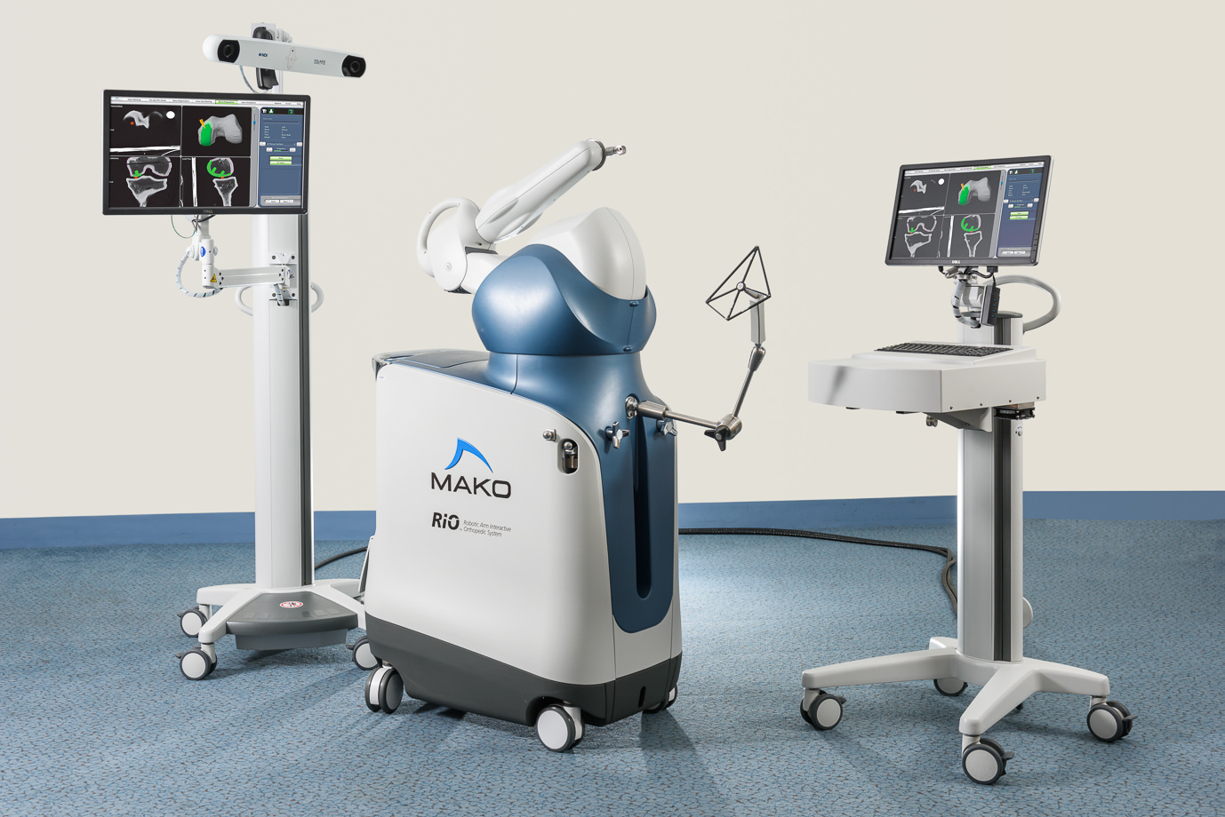
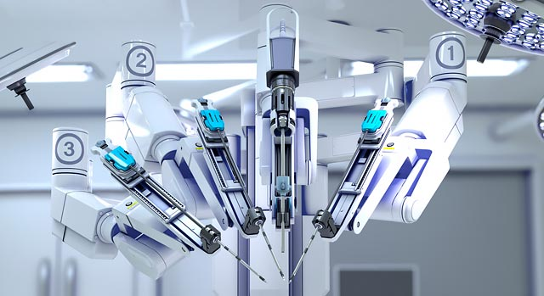
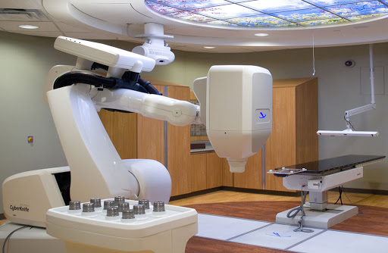
ROBOTIC SURGERY, A NEW ERA...
Enhanced dexterity.
Increased accuracy.
Lower chance of complications.
Easier recovery.
29/04/2020
Page 2

Slide 3
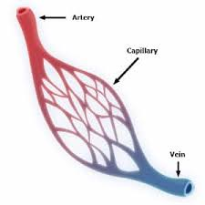
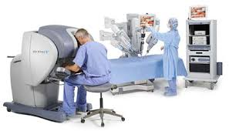
… WITH STILL SOME PROBLEMS
0.1mm - 10mm
5µm - 10µm
Training.
Lack of sensory feedback (tactile and force).
Size.
Malfunctioning.
1mm - 15mm
29/04/2020
Page 3

Slide 4
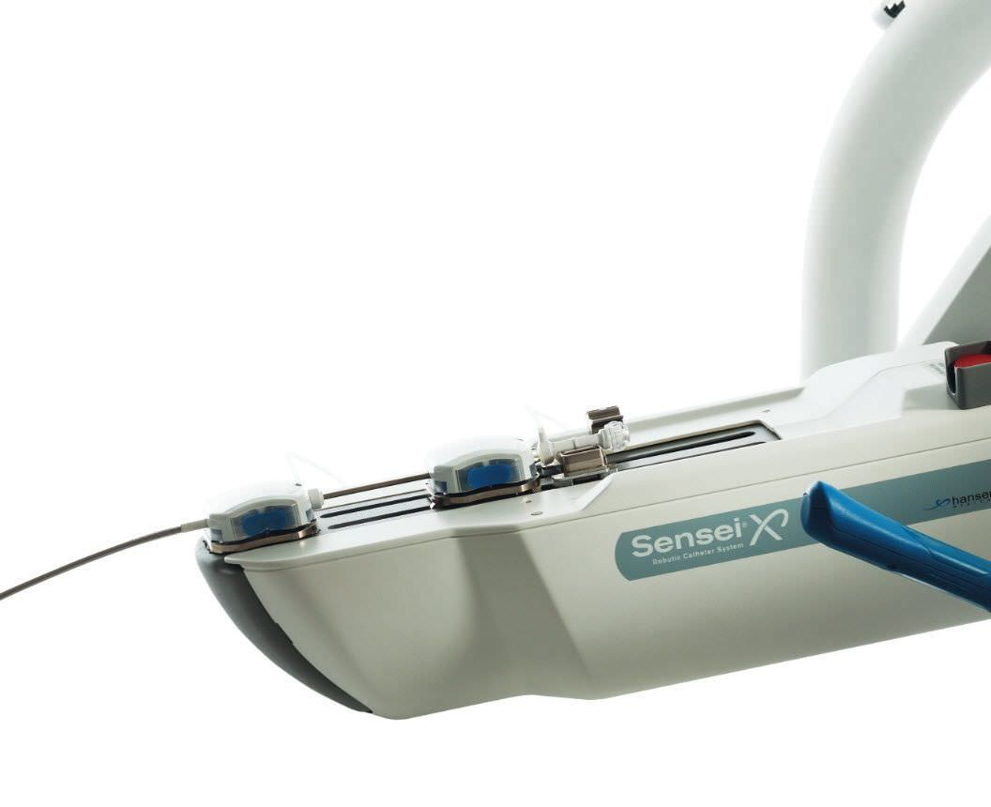
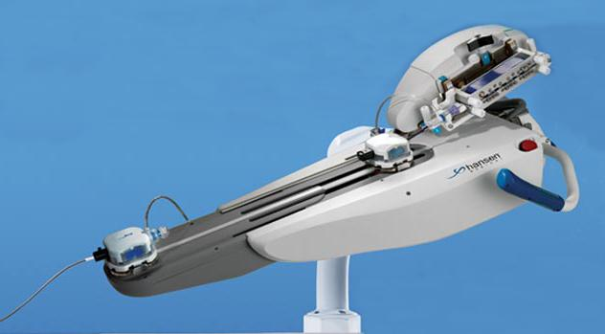
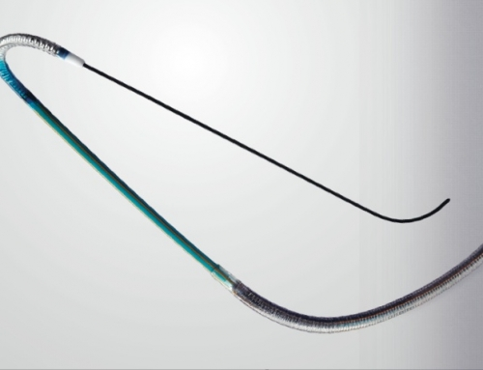
ENDOVASCULAR CATHETERS
Hansen Magellan
Artisan Extend
Sensei X
29/04/2020
Page 4

Slide 5


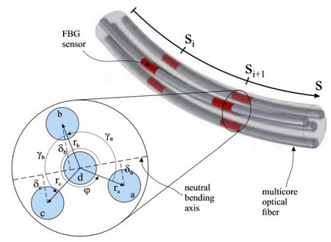
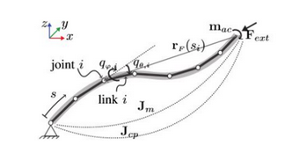
MODEL OF A FLEXIBLE PROBE
Different approaches for:
KINEMATIC STRUCTURE:
Single rigid body
Chain of elastic links
Chain of rigid links
FORCE ESTIMATION:
Curvature + Cosserat rod model
FBG sensors
29/04/2020
Page 5

Slide 6
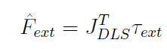
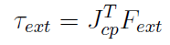
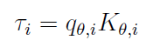
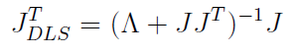
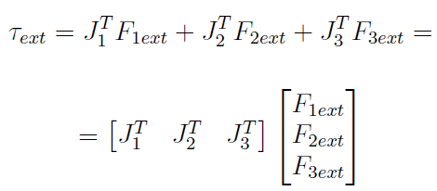
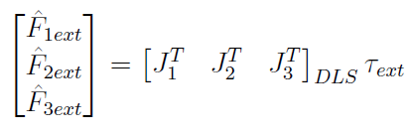
CONTACT FORCES COMPUTATION
Torque vector
Invert
Single contact point
contact point Jacobian
external wrench
Single torque component
Multiple contact points
i-th bending amount
i-th flexural stifness
Invert
29/04/2020
Page 6

Slide 7

V-REP ENVIRONMENT
3-D simulation software.
Version used 3.6.2.
Many problem to overcome:
- missing material properties;
- search for the best combination of links and joints;
- tweaking of internal parameters ;
29/04/2020
Page 7

Slide 8
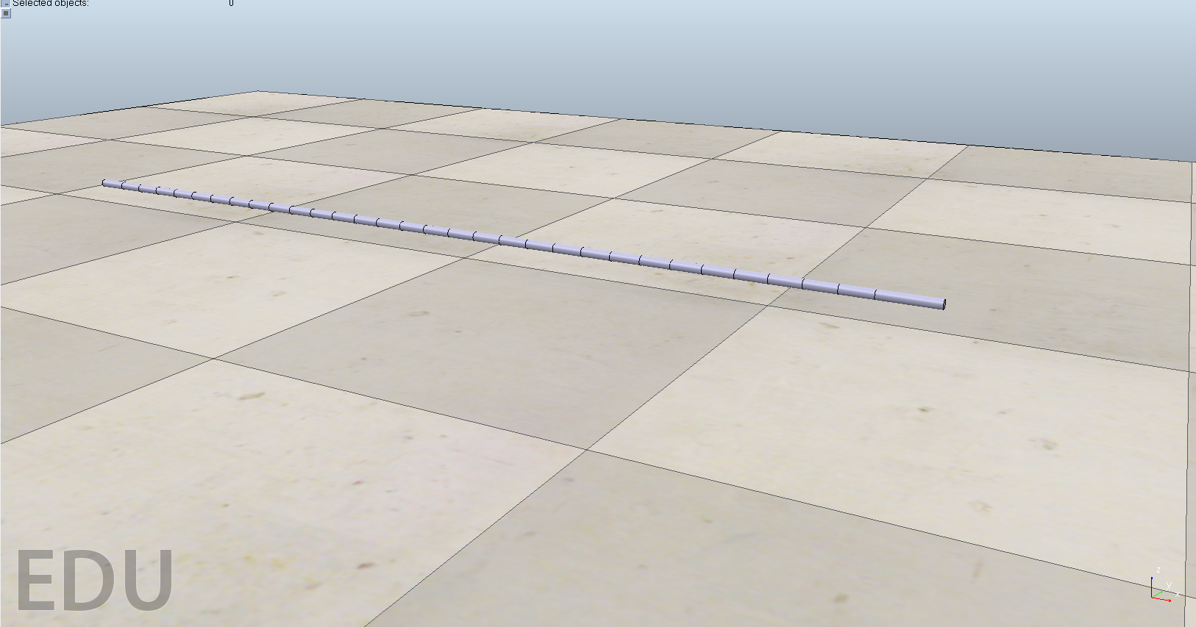
FLEXIBLE PROBE - COMPONENTS
1. Links
32 links divided into:
Link n.1 connected to the base.
Link n.2 to Link n.31 attached one after the other.
Link n.32 tip of the probe.
Non-dynamic
Great variety of shape
34 cm long
Simulation problems!
29/04/2020
Page 8

Slide 9
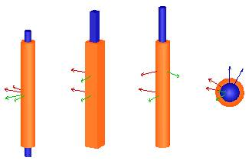
FLEXIBLE PROBE - COMPONENTS
2. Joints
Dynamic.
Used to build the chain structure.
Three types of interest.
Different behavioural properties.
Controllable in different ways.
Revolute
Prismatic
Shperic
29/04/2020
Page 9

Slide 10
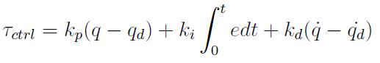
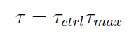
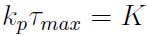
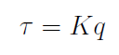
FLEXIBLE PROBE - COMPONENTS
2.1 Joints elasticity
Control joints via a PID controller
TORQUE DUE TO THE CONTROL MODE
Set derivative and integral gain to 0
Choose k_{p} and τ_{max} such that
At rest q_{d}=0, so
SPRING DAMPED control mode
29/04/2020
Page 10

Slide 11
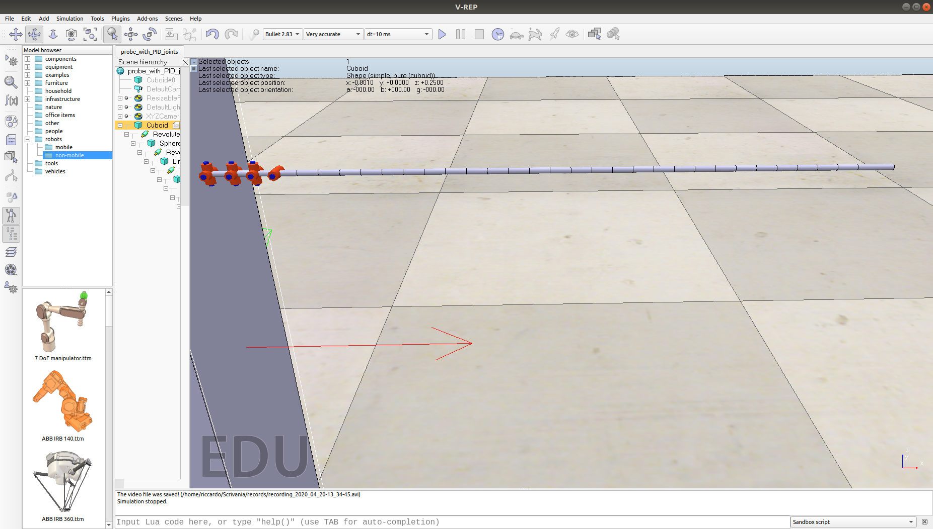
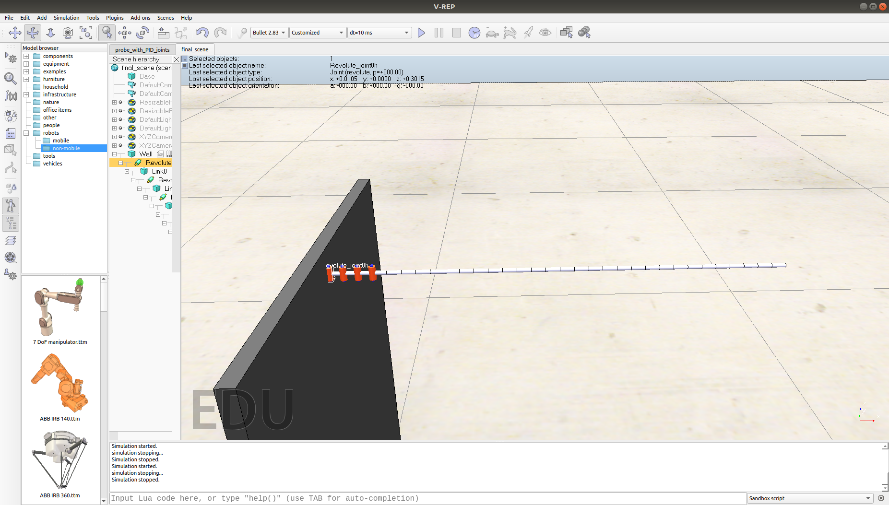
FLEXIBLE PROBE - SETTINGS
2 DOFs case
1 DOF case
29/04/2020
Page 11

Slide 12
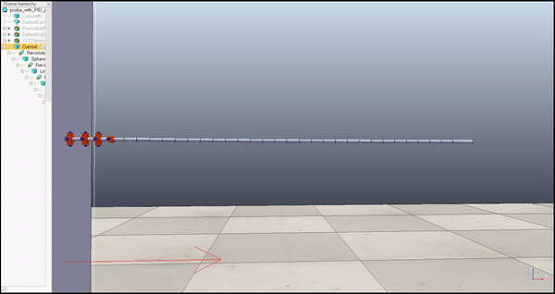
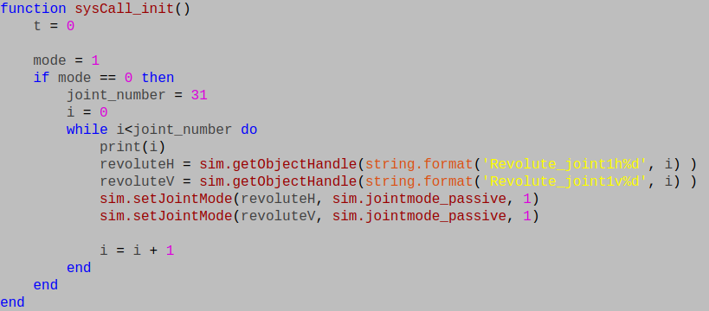
FLEXIBLE PROBE - SETTINGS
 | GRAVITY ON | GRAVITY OFF
PASSIVE JOINTS | X
ACTIVE JOINTS
2 DOFs case​
29/04/2020
Page 12

Slide 13
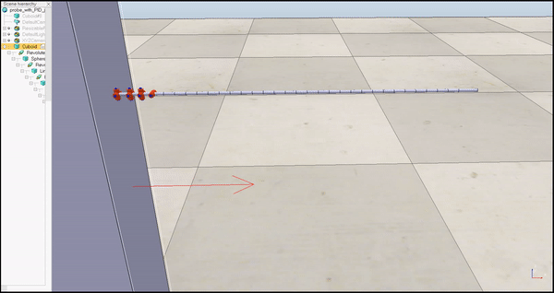
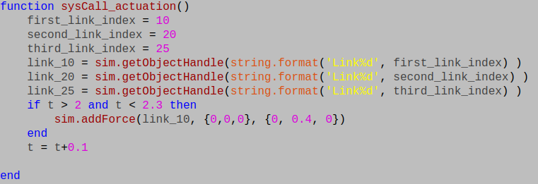
FLEXIBLE PROBE - SETTINGS
 | GRAVITY ON | GRAVITY OFF
PASSIVE JOINTS |  | X
ACTIVE JOINTS
2 DOFs case​
29/04/2020
Page 13

Slide 14
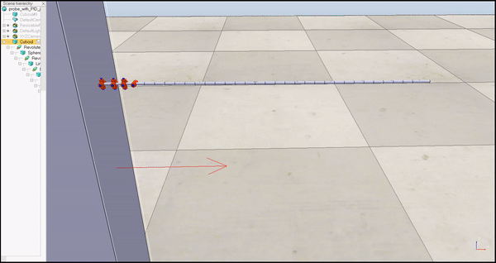
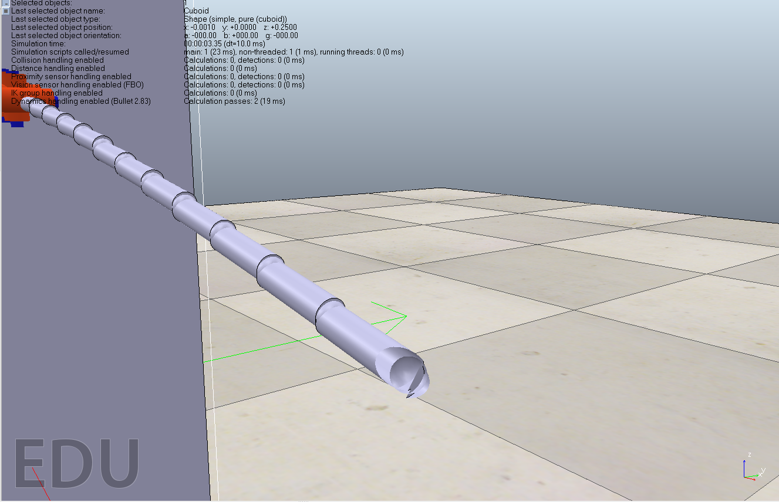
FLEXIBLE PROBE - SETTINGS
 | GRAVITY ON | GRAVITY OFF
PASSIVE JOINTS
ACTIVE JOINTS | X
2 DOFs case​
29/04/2020
Page 12

Slide 15

FLEXIBLE PROBE - SETTINGS
 | GRAVITY ON | GRAVITY OFF
PASSIVE JOINTS
ACTIVE JOINTS |  | X
2 DOFs case​
29/04/2020
Page 15

Slide 16
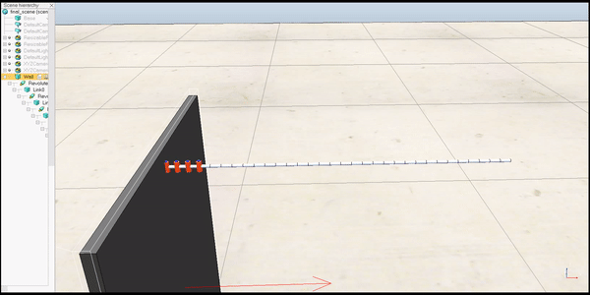
FLEXIBLE PROBE - SETTINGS
 | GRAVITY ON | GRAVITY OFF
PASSIVE JOINTS | X
ACTIVE JOINTS
1 DOF case​
29/04/2020
Page 16

Slide 17
FLEXIBLE PROBE - SETTINGS
 | GRAVITY ON | GRAVITY OFF
PASSIVE JOINTS |  | X
ACTIVE JOINTS
1 DOF case​
29/04/2020
Page 17

Slide 18

FLEXIBLE PROBE - SETTINGS
 | GRAVITY ON | GRAVITY OFF
PASSIVE JOINTS
ACTIVE JOINTS | X
1 DOF case​
29/04/2020
Page 18

Slide 19

FLEXIBLE PROBE - SETTINGS
 | GRAVITY ON | GRAVITY OFF
PASSIVE JOINTS
ACTIVE JOINTS |  | X
1 DOF case​
29/04/2020
Page 19

Slide 20
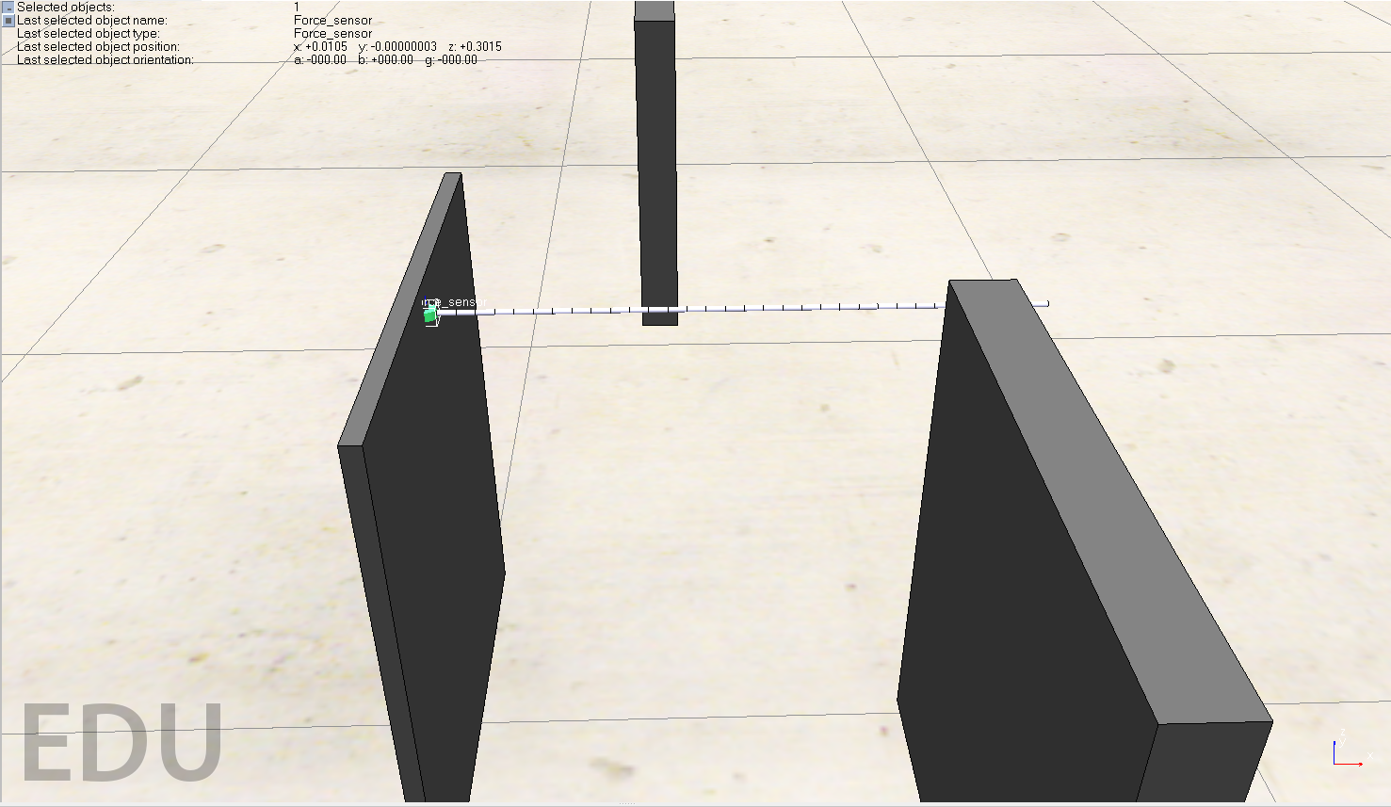
FLEXIBLE PROBE - EXPERIMENTS
Model validation
Spring Damper mode
Force sensor
Three experiments:
Single force at the tip
Three forces along the structure
Six forces along the structure
29/04/2020
Page 20

Slide 21
EXPERIMENT STEPS
Apply forces on some links;
collect at each instant torque, joints and force measurements;
pass the measurements to Matlab;
compute the contact Jacobian at each instant;
filter joint and torque measurements;
estimate forces;
smooth estimated forces;
29/04/2020
Page 21

Slide 22
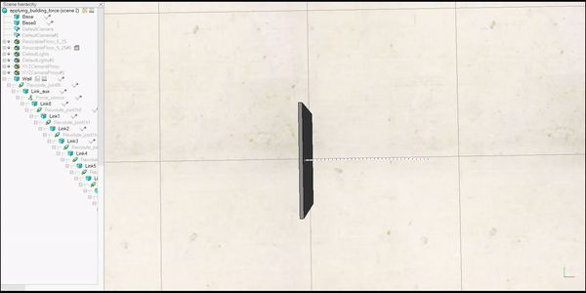
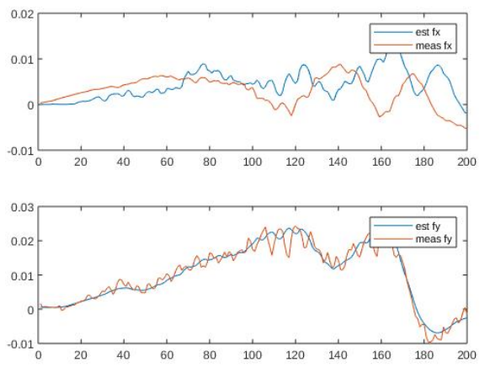
EXPERIMENT 1 - SINGLE FORCE
Constant force produces wrong behaviour.
Use of a linearly increasing and decreasing force.
29/04/2020
Page 22

Slide 23
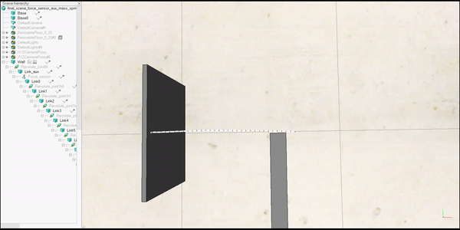
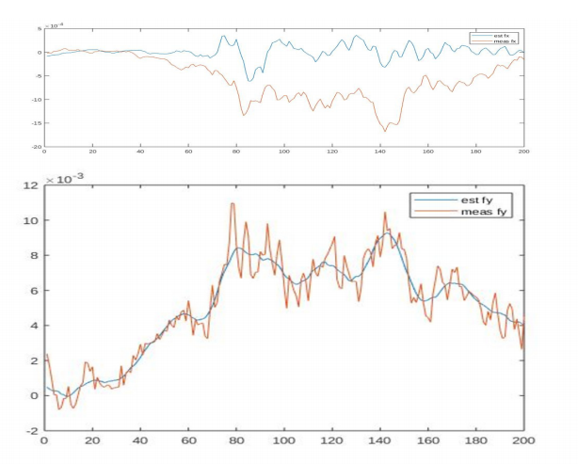
EXPERIMENT 2 – THREE FORCES
Same type of force as before.
Force produced by a collision with a world object.
Contact points along the probe are known (link 27,28,29).
29/04/2020
Page 23

Slide 24
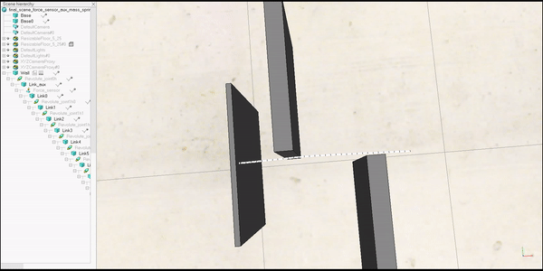
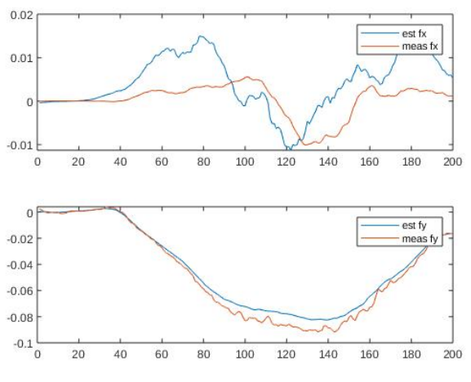
EXPERIMENT 3 – SIX FORCES
Identical to the previous case but with three additional contact points (7,8,9,10,25,26).
29/04/2020
Page 24

Slide 25
CONCLUSIONS
Challenges in reproducing the dynamic properties of a flexible probe.
V-REP fails to handle a large number of small size objects attached one to another.
Prominent oscillations are produced together with lots of vibrations.
This effect amplifies as more DOFs are addressed.
Elastic effect of materials can be reproduced through "specific" control laws.
The proposed estimation method is more accurate on the Y direction than on the X direction.
29/04/2020
Page 25

